Slide 1
Module 11
Implementing and managing Exchange Online deployments
Notes:
Presentation: 60 minutes
Lab: 45 minutes
After completing this module, students will be able to:
Provide an overview of Exchange Online and Office 365.
Manage Exchange Online.
Implement a migration to Exchange Online.
Required Materials
To teach this module, you need the Microsoft Office PowerPoint file 20345-1A_10.pptx.
Preparation tasks
To prepare for this module:
Read all of the materials for this module.
Practice performing the demonstrations.
Practice performing the labs.
Work through the Module Review and Takeaways section, and determine how you will use this section to reinforce student learning and promote knowledge transfer to on-the-job performance.
As you prepare for this class, it is imperative that you complete the labs yourself so that you understand how they work and the concepts that are covered in each. This enables you to provide meaningful hints to students who might experience issues with a lab. Furthermore, it will help guide your lecture so that you discuss the concepts that the labs cover.
20345-1A
10: Implementing and managing Exchange Online deployments

Slide 2
Module Overview
Overview of Exchange Online and Office365 Managing Exchange Online Implementing the migration to Exchange Online
Notes:
20345-1A
10: Implementing and managing Exchange Online deployments

Slide 3
Lesson 1: Overview of Exchange Online and Office 365
What is Office 365? What is Exchange Online? Why migrate to Exchange Online? Exchange Online user subscriptions Exchange Online deployment scenarios Coexistence between on-premises Exchange Server and Exchange Online
Notes:
20345-1A
10: Implementing and managing Exchange Online deployments

Slide 4



What is Office 365?
Exchange Online
Skype for Business
Online
Office 365 ProPlus
SharePoint Online
Azure AD
Notes:
Introduce the five Microsoft products that are bundled as Microsoft Office 365. Mention that this module covers only Exchange Online, not the other products. You might want to give examples of when to use the other services, such as Microsoft Skype for Business Online, which can connect to an on-premises Skype for Business server.
20345-1A
10: Implementing and managing Exchange Online deployments

Slide 5
What is Exchange Online?
Exchange Online includes:
Migration and hybrid deployment
Compliance and archiving
Multiple management tools
Enhanced web experience
Advanced routing options
Exchange Online Protection
Hosted voicemail with Unified Messaging
Public Folders
Address Book Policies
Notes:
Provide an overview of the features available in Exchange Online.
20345-1A
10: Implementing and managing Exchange Online deployments

Slide 6
Why migrate to Exchange Online?
Top reasons why an organization might consider migrating to Exchange Online:
Cost
Administration effort
Disaster recovery effort
Flexibility
Environmental friendliness
For each organization, the reasons to consider Exchange Online are different, so you should evaluate them carefully
Notes:
20345-1A
10: Implementing and managing Exchange Online deployments

Slide 7
Exchange Online user subscriptions
The available Exchange Online user subscriptions are:
Exchange Online Kiosk for mailbox size up to 1 GB
Exchange Online Plan 1 for 50 GB combined primary and archive mailboxes
Exchange Online Plan 2 for 50 GB primary mailbox plus unlimited Personal Archives
Exchange Online Kiosk is the most basic user subscription, and it includes only Outlook Web App, POP3, or ActiveSync access to the mailbox
Exchange Online Plan 2 includes advanced features, such as in-place hold and voicemail
Notes:
This topic provides an overview of the Exchange Online subscriber options that are available. Mention that Microsoft often changes these policies, so students must be sure to use the most recent information about subscriptions for their planning.
20345-1A
10: Implementing and managing Exchange Online deployments

Slide 8






Exchange Online deployment scenarios
Choose the type of deployment that best fits your business needs
Hybrid deployment
Exchange Server
Exchange Online
Desktop computer
Phone
Tablet
Notes:
Briefly present the Exchange Online deployment scenarios. Mention that Exchange Online can provide a hybrid deployment, which is the only cloud messaging solution in the market that can coexist with an on-premises messaging solution.
20345-1A
10: Implementing and managing Exchange Online deployments

Slide 9
Coexistence between on-premises Exchange Server and Exchange Online
Coexistence requires the following:
Decide if you can and want to use Directory Synchronization or a one-time Synchronization
Mail flow between on-premises and Exchange Online must be configured properly
Decide where the DNS MX record is configured, either to on-premises Exchange or to Exchange Online
Exchange Online settings must match the on-premises Exchange settings
Notes:
Discuss the important areas to consider for implementing and managing coexistence between on-premises Exchange and Exchange Online.
20345-1A
10: Implementing and managing Exchange Online deployments

Slide 10
Lesson 2: Managing Exchange Online
Creating an Office 365 tenant Demonstration: Creating an Office 365 trial tenant Overview of the Office 365 administrative portals Demonstration: Overview of the Office 365 admin center Exchange Online management Demonstration: Provisioning users, groups, and mailboxes in Office 365 Demonstration: Connecting to Exchange Online by using Windows PowerShell
Notes:
20345-1A
10: Implementing and managing Exchange Online deployments

Slide 11

Creating an Office 365 tenant
Select plan
Obtain external email account
1
2
Click trial link
3
Validate sign-up
Enter company data
5
4
Notes:
Highlight the simplicity of the sign-up process, but stress that this simplicity can be deceptive, because it is easy to make a mistake.
20345-1A
10: Implementing and managing Exchange Online deployments

Slide 12
Demonstration: Creating an Office 365 trial tenant
In this demonstration, you will see how to create an Office 365 trial tenant
Notes:
Demonstration Steps
On the host computer, open Internet Explorer, browse to the Office 365 Enterprise E3 business software link: http://aka.ms/jsn2ec
Select the Free trial option.
Select your country/region and enter your data. If your country/region is not listed, select United States.
Type in your First name and Last name, enter an email address you have access to, type 123-123-1234 as the business phone number, and use A. Datum Corporation as the company name. Choose 51-150 for the organization size, and then click Next.
On the Create your user ID page, type your user name (for example, the first letter of your last name and your first name), and then choose a company domain name. Type the company domain name in the following format: AdatumDATEYourInitials.onmicrosoft. (for example, adatum2601sj.onmicrosoft.com)
Configure Pa$$w0rd! as the password, and then click Next.
Provide your mobile phone number for verification, and then click Text me.
Note: You must type your working mobile phone number.
Type the text code that you received on your mobile phone in the Enter your verification code dialog box, then click Create my account.
Review the available options on the Office 365 dashboard, and note your user ID.
Note: Make sure that you write down your user ID, because you will use it later for signing in.
Do not close the browser window.
20345-1A
10: Implementing and managing Exchange Online deployments

Slide 13
Overview of the Office 365 administrative portals
Office 365 administrative tools include:
Web-based administrative portals:
Office 365 admin center
Exchange admin center
Skype for Business admin center
SharePoint admin center
Compliance Center
Azure Active Directory Module for Windows PowerShell
Notes:
Describe to students the Office 365 administrative tools. Mention that each Office 365 component utilizes a different Windows PowerShell module and a different way of connecting that module to the cloud.
20345-1A
10: Implementing and managing Exchange Online deployments

Slide 14
Demonstration: Overview of the Office 365 admin center
In this demonstration, you will see how to use the Office 365 admin center
Notes:
Demonstration Steps
Office 365 admin center
On the host machine, in Internet Explorer, click Start InPrivate Browsing, and then browse to https://portal.office.com.
Log on with your previously created UserID and the password Pa$$w0rd!
Click Admin. On the don’t lose access to your account! page, click cancel.
If you are connected to the previous Office 365 admin center, click the banner at the top of the page to connect to the new Office 365 admin center.
On the left navigation menu, scroll down to explore all available items.
On the left navigation menu, click Users, and then click Active Users.
Review the users list.
On the left navigation menu, click Settings, and review the options listed.
Click each option, and discuss the configuration options.
On the left navigation menu, click Health, and review the options listed.
Click each option, and discuss the configuration options.
Do not close the browser window.
20345-1A
10: Implementing and managing Exchange Online deployments

Slide 15
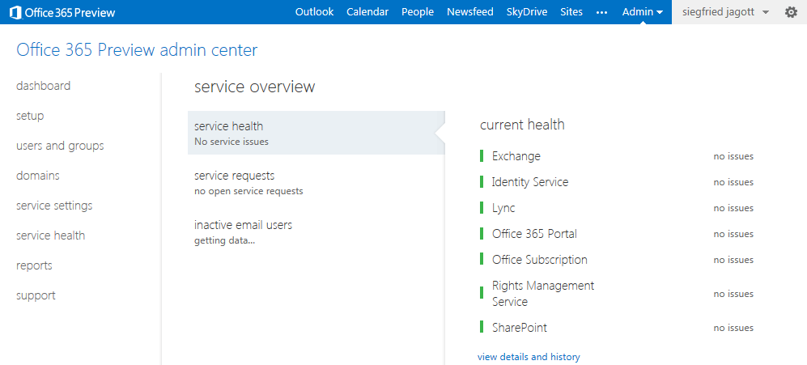
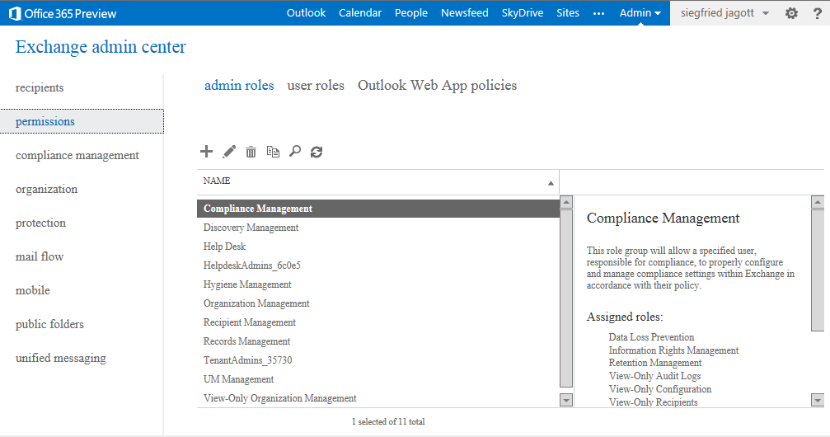
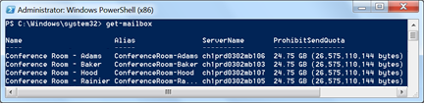
Exchange Online management
Office 365 admin center
Exchange admin center
Windows PowerShell
Notes:
20345-1A
10: Implementing and managing Exchange Online deployments

Slide 16
Demonstration: Provisioning users, groups, and mailboxes in Office 365
In this demonstration, you will see how to provision Users, Groups and Mailboxes in Office 365
Notes:
Demonstration Steps
Provision users and mailboxes
In the host machine, in Internet Explorer, in the Office 365 admin portal, on Home page, click Users, and then click Active users.
Above the list of users, click the Add a user button.
On the New user page, enter the following information, and then click Save:
First name: Beth
Last name: Burke
Display name: Beth Burke
User name: Beth
Auto-generate password.
Make this user change their password when they first sign in: Selected
Product licenses: Office 365 Enterprise E3
Click Save
Ensure that the Send password in email check box is selected, click Send email and close, and then repeat steps 2-3 to add the following additional users:
Annete Auzina
Fay Gibbs
In the Office 365 admin console, in the left navigation pane, click Admin centers, and then click Exchange.
In the Exchange admin center, click recipients.
20345-1A
10: Implementing and managing Exchange Online deployments
(More notes on the next slide)

Slide 17
Demonstration: Connecting to Exchange Online by using Windows PowerShell
In this demonstration, you will see how to connect to Exchange Online using Windows PowerShell
Notes:
Preparation Steps
This demonstration requires the host computer to be able to access the Internet directly to connect to Exchange Online by using Windows PowerShell.
Demonstration Steps
On the host computer, open Windows PowerShell as an administrator.
If a User Account Controller dialog box appears, click Yes.
In Windows PowerShell, change the execution policy by running the following command, and then press Enter.
Set-executionpolicy unrestricted -force
Get login credentials by running the following command , and then press Enter:
$cred = Get-Credential
In the Login to Windows PowerShell dialog box, type your previously created UserID as user name and Pa$$w0rd! as the password, then click OK.
Create a session to Exchange Online PowerShell by running the following command, and then press Enter:
$exo = New-PSSession -ConfigurationName Microsoft.Exchange -ConnectionUri https://outlook.office365.com/powershell-liveid/ -Credential $cred -Authentication Basic -AllowRedirection
Import all Exchange Online PowerShell cmdlets by running the following command, and then press Enter:
Import-PSSession $exo
20345-1A
10: Implementing and managing Exchange Online deployments
(More notes on the next slide)

Slide 18
Lesson 3: Implementing the migration to Exchange Online
Migration options Migration scenarios Coexistence between Office 365 and on-premises Exchange Server Preparing for migration Migration steps Best practices for implementing migration
Notes:
20345-1A
10: Implementing and managing Exchange Online deployments

Slide 19
Migration options
Migration | IMAP migration | Supports a wide range of email platforms Email only (no calendar, contacts, or desks)
 | PST migration | Mailbox data is exported from Outlook to PST files and then the PST files imported in Exchange Online Mailboxes must be created in Office 365
 | Cutover Exchange migration | Good for fast, direct migrations Does not need a server on-premises
Coexistence | Staged Exchange migration | Supports staged migrations Requires Directory Synchronization
 | Hybrid deployment | You can manage users on-premises and online Enables cross-premises calendaring, smooth migration, and easy off-boarding Automatically redirects clients
Notes:
Explain the available migration options for Exchange Online. Customers can choose to move to the cloud quickly with native migration options, to take a more measured approach according to their business requirements, or to maintain mailboxes on-premises and online for a longer period of time.
20345-1A
10: Implementing and managing Exchange Online deployments

Slide 20
Migration scenarios
 | IMAP migration | Cutover | Staged | Exchange 2010 hybrid | Exchange 2013 hybrid | Exchange 2016 hybrid | Exchange 2019 hybrid
Exchange 5.5 or 2000 | X
Exchange Server 2003 | X | X | X | X
Exchange Server 2007 | X | X | X | X | X
Exchange Server 2010 | X | X | X | X | X | X | X
Exchange Server 2013 | X | X | X | X | X |  | X
Exchange Server 2016 | X | X | X | X | X | X | X
Lotus Notes/ Domino | X
GroupWise/ Other | X
Notes:
Explain the various migration scenarios that are available to migrate to Exchange Online.
20345-1A
10: Implementing and managing Exchange Online deployments

Slide 21
Coexistence between Office 365 and on-premises Exchange Server
Migration Option | Impact on Coexistence
IMAP migration | No coexistence available; just basic mail data migration
Cutover migration | Not a real coexistence (user account and data) Just switch DNS MX (No mail routing coexistence required)
Staged migration | Requires directory synchronization and mail routing between on-premises Exchange and Exchange Online
Hybrid deployment | Requires Exchange 2010 or later Requires directory synchronization and mail routing for coexistence SMTP email entry point can be on-premises or online Full-featured coexistence available, including free/busy data and Public Folder migrations
Notes:
This topic provides an overview of the coexistence impacts associated with specific migration options.
20345-1A
10: Implementing and managing Exchange Online deployments

Slide 22
Preparing for migration
To prepare for migration consider the following:
Perform an Active Directory check and cleanup
Decide what information should be migrated
Reduce the amount of data to be migrated
Update your Outlook clients to the latest version
Notes:
Explain to the students that the topics mentioned on the slide are just a starting point, and that additional topics might be important to each and every student. If you have time, you might want discuss additional preparation areas that are not included on the slide.
20345-1A
10: Implementing and managing Exchange Online deployments

Slide 23
Migration steps
To migrate to Exchange Online:
Connect directory and message routing to Exchange Online
Migrate the mailboxes
Switch the MX resource record so that it points to Exchange Online
Finalize the migration and remove the old Mailbox servers
Notes:
Discuss the high-level steps in a migration to Exchange Online. Explain each step in detail and describe how to do each step. Also, mention that a hybrid deployment includes several other steps, and that the next lesson provides more details.
20345-1A
10: Implementing and managing Exchange Online deployments

Slide 24
Best practices for implementing migration
To test on-premises Exchange Server or SMTP server from the Internet, use the Microsoft Remote Connectivity Analyzer
Test the migration option before you move production mailboxes
Start slowly, and up speed increase after everything is working
Do not change the MX resource record until you know that the migration option is working
In a hybrid deployment, always use the Hybrid Configuration Wizard app
Notes:
Mention that best practices tend to change, so users should feel free to add their own experiences to this topic.
20345-1A
10: Implementing and managing Exchange Online deployments

Slide 25
Lab: Managing Exchange Online
Exercise 1: Managing Exchange Online
Estimated Time: 50 minutes
Notes:
Exercise 1: Managing Exchange Online
A. Datum is considering moving some of the mailboxes for some users to Office 365 Exchange Online. Before deciding on a migration option, they want to implement a test environment with a few test accounts so that they can evaluate functionality.
Instructor Note: This lab can only be done on a machine that is connected to the Internet.
20345-1A
10: Implementing and managing Exchange Online deployments

Slide 26
Lab Scenario
A. Datum is considering moving some mailboxes to Exchange Online. A. Datum wants to ensure not only that the users can still use their internal adatum.com domain accounts to authenticate, but also that they can access their mailboxes online. The mailbox location should be transparent to users when they access their mailbox, send email messages, or book meetings.
Notes:
20345-1A
10: Implementing and managing Exchange Online deployments

Slide 27
Lab Review
Where in Office 365 do you manage recipient objects such as recipients or groups? What options do you have to manage Exchange Online?
Notes:
Question
Where in Office 365 do you manage recipient objects such as recipients or groups?
Answer
You can use the Exchange Online admin center to manage recipients and groups.
Question
What options do you have to manage Exchange Online?
Answer
You can use Exchange Online admin center or Windows PowerShell to remotely connect to Exchange Online. You also can use the Office 365 admin center to create users and mailboxes, but you cannot manage mailboxes in the Office 365 admin center.
20345-1A
10: Implementing and managing Exchange Online deployments

Slide 28
Module Review and Takeaways
Review Questions
Notes:
Review Questions
Question
How can you deploy Exchange Online?
Answer
You can use Exchange Online only, Exchange Server on-premises only, or a hybrid deployment that connects Exchange Server on-premises and Exchange Online.
Question
How can you manage users and mailboxes in Office 365? Which portals can you use?
Answer
You can use Office 365 admin center to create and delete users including their mailboxes. You need to use Exchange Online admin center to manage mailbox-specific settings such as email addresses or mailbox features.
Question
You created a new mailbox in Exchange Online, and now the on-premises users complain that they cannot see the new mailbox. What can you do?
Answer
You cannot make the new mailbox visible to viewers, because there is no way to synchronize Exchange Online mailboxes or accounts to the on-premises environment. To correct this problem, you need to delete and then re-create the mailboxes in the on-premises Active Directory Domain Services (AD DS) by using the Exchange admin center or Exchange Management Shell. Then you need to wait for the directory synchronization tool to synchronize the mailbox to Exchange Online.
Ensure that you cover the common issues and the corresponding troubleshooting tips listed in this section. Encourage students to share tips from their own work environments.
20345-1A
10: Implementing and managing Exchange Online deployments

